Slide 1
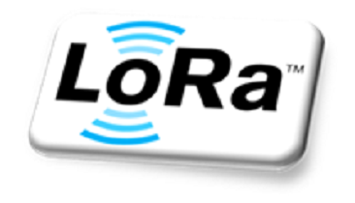
LoRa - LoRaWAN

Slide 2
LoRa Technology
There are several key elements of the LoRa wireless system. Some of its key features include the following:
Long range: 15 - 20 km.
Millions of nodes
Long battery life: in excess of ten years
LoRa technology consists of several elements:
RF interface / physical layer : The LoRa physical layer governs the aspects of the RF signal that is transmitted between the nodes or endpoints, i.e. the sensors and the LoRa gateway where signals are received. It governs aspects of the signal including the frequencies, modulation format, power levels, signalling between the transmitting and receiving elements, and other related topics.
LoRa network architecture: Apart from the RF elements of the LoRa wireless system, there are other elements of the network architecture, including the overall system architecture, backhaul, server and the application computers.

Slide 3
LoRa Physical Layer
The LoRa RF or physical layer encapsulates the all the direct contact with the outside world over the radio interface.
The RF parameters including frequencies, bands, power levels, modulation, and the basic RF protocols are all encapsulated in the LoRa RF or physical layer attributes.
LoRa frequency bands
The LoRa wireless system makes use of the unlicensed frequencies that are available worldwide. The most widely used frequencies / bands are:
868 MHz for Europe
915 MHz for North America
433 MHz band for Asia
Using lower frequencies than those of the 2.4 or 5.8 GHz ISM bands enables much better coverage to be achieved especially when the nodes are within buildings.

Slide 4
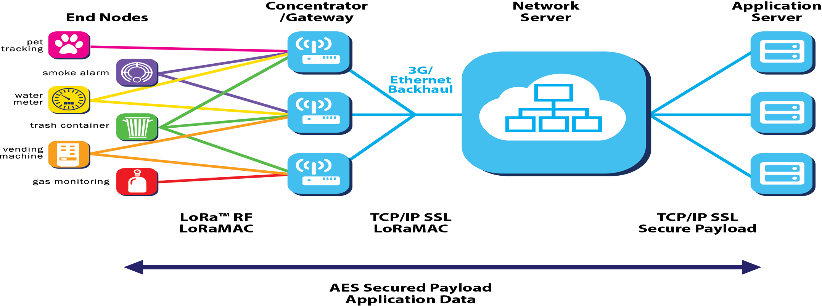
LoRa architecture

Slide 5
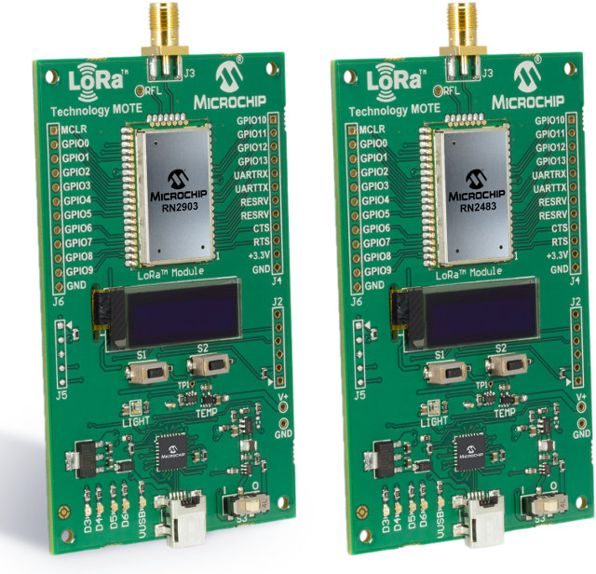
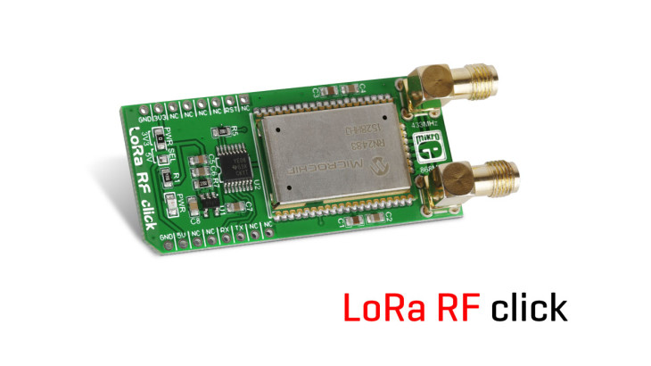
Microchip RN2483

Slide 6
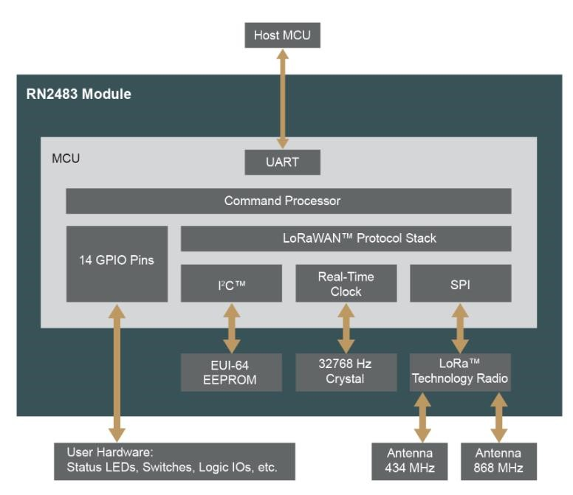
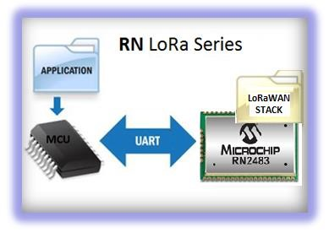
Microchip RN2483

Slide 7
